Slide 1
Vue JS 102
SPA Time!

Slide 3
Module 1 - Advanced Components
Slots Easy way to pass from Parent to Child
Dynamics Catching and ‘Not Reloading’ a component when you go back
Async Component
Only loading a component when you ask for it. Turn it into a function

Slide 4
Dynamics
Keeping Alive ‘state’ when you come back
A → AA
B
A
AA?

Slide 5
Module 2 - Prop (Properties)
Dynamic Props Using props but binding the input so that you can pass variables from grandparent -> parent -> child
Props validation added a Type so you don’t get passes nonsense

Slide 6
Module 3 - Mixins (Mix In)
Takes 1 components functions and mix it into another one
Great for apply a function across many types of instances

Slide 7

4. Vuex
Centre State Management
“How many drinks did we order?”

Slide 8
Module 4
Vue Cli and Router

Slide 9
Vue Cli
Vue provides an official CLI for quickly scaffolding ambitious Single Page Applications
Vue Cli is a full system for rapid Vue.js development platform. It allows you to create Vue App can also be deployed on the server
Vue Cli is based on node.js

Slide 10
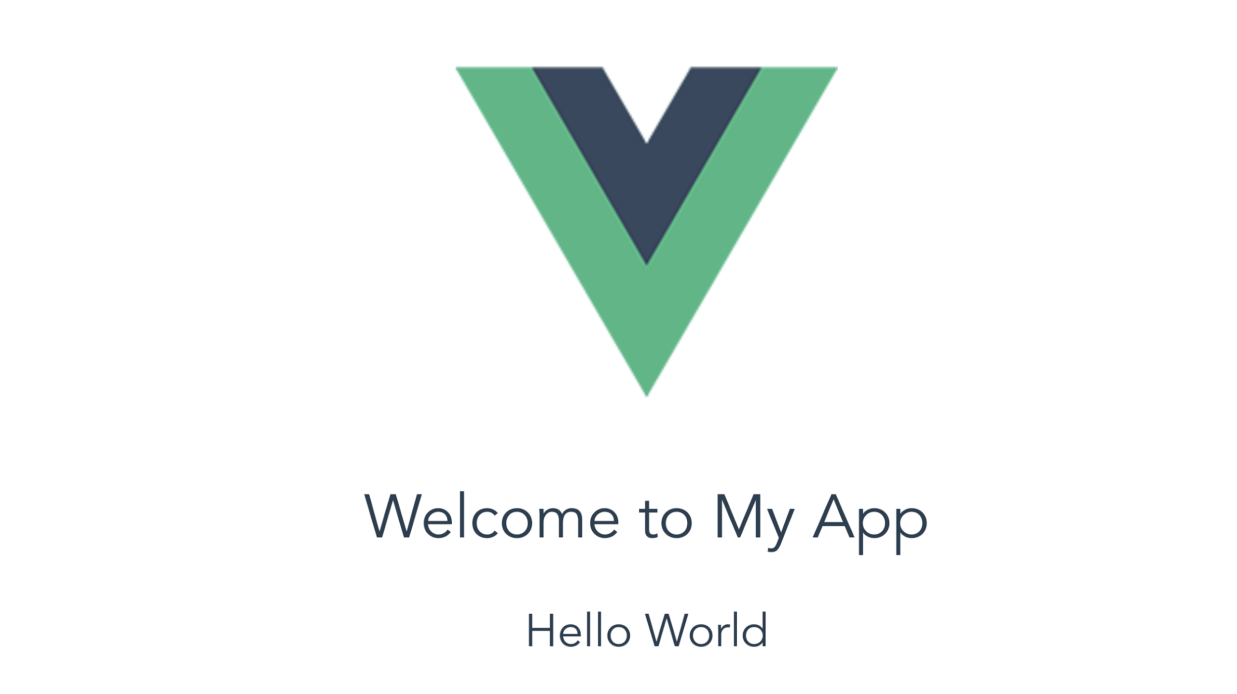
Ex: Vue App
Create a new Vue app, and change the text to below

Slide 11

SPA Single Page Application

Slide 12
Secret Level – Build A Registration App
Lionel wants to build a coffee break app
People want to attend a coffee break and also list their favourite drink.
Some people change their mind and cancel
People named ‘Lisa’ not allow to attend coffee break, they are not allowed to register

Slide 13
Single Page Applications
Using SPA there is no need to refresh the page every time we make a request to the server
Vue Router helps us create SPA

Slide 14
Installing Node JS
Download and Install Node JS https://nodejs.org/en/download/
To test if Node JS was installed successfully type the following commands on your Windows CMD Prompt / Mac Terminal
node -v
To test if Node Package Manager (NPM) was installed successfully, type
npm -v

Slide 15
Install Vue CLI
To install Vue CLI, type the following command to your Windows CMD Prompt or Mac Terminal
npm install -g vue-cli

Slide 16
Create Vue Project
To create Vue project, type the following command to your Windows CMD Prompt or Mac Terminal:
vue init webpack myapp
cd myapp
npm run dev

Slide 17
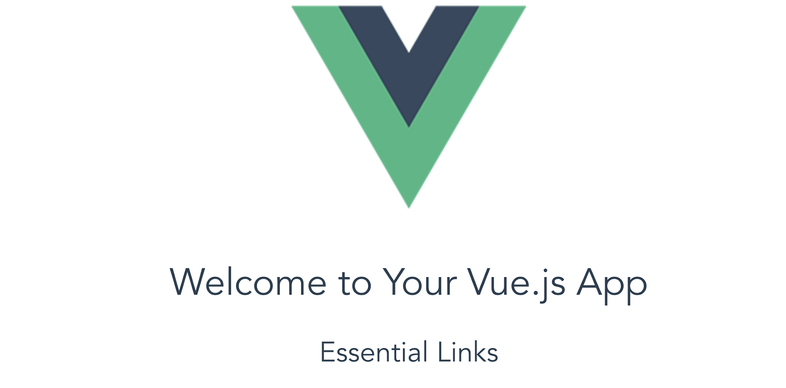
Vue App
View on the browser http://localhost:8080/

Slide 18
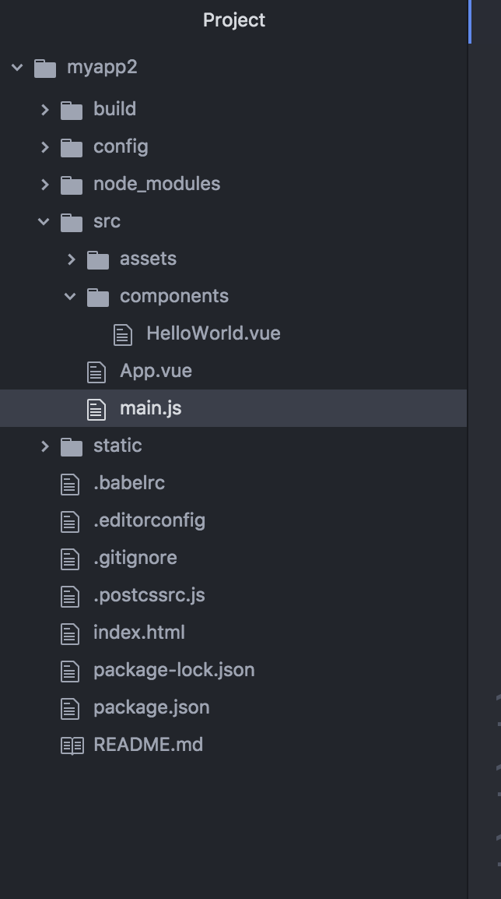
Vue App Structure
The main.js will call the main component App.vue
App.vue component consist of the subcomponents
Each component has template, script and style

Slide 19
Installing Vue Router
To install the vue router libraries, add the following javascript on the head section of your HTML file
<script src="https://unpkg.com/vue-router"></script>

Slide 20
Router Link
<router-link> is a component used to navigate to the HTML content to be displayed to the user. The to property is the destination
<p>
<router-link to = "/route1">Router Link 1</router-link>
<router-link to = "/route2">Router Link 2</router-link>
</p>

Slide 21
Templates
You can define constants for the templates of each route
const Route1 = { template: '...' }
const Route2 = { template:' …'}

Slide 22
Route Path
You can define the constant to match the URL to each routes
const routes = [
{ path: '/route1', component: Route1 },
{ path: '/route2', component: Route2 }
];

Slide 23
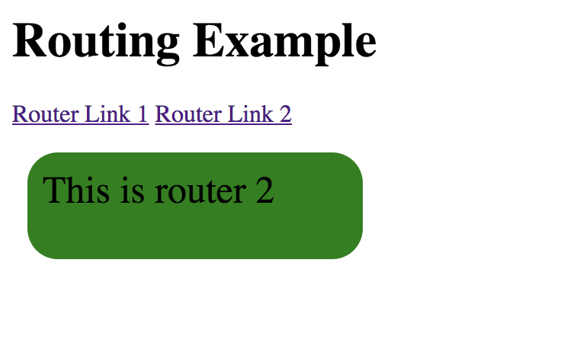
Router Instance
The VueRouter constructor takes the routes as the param
const router = new VueRouter({
routes: routes
});

Slide 24
Ex: Router
Add one more routes Route3 to the router demo
Time: 5 mins

